Slide 1


STROKE
Don’t be a victim
Protect yourself

Slide 2
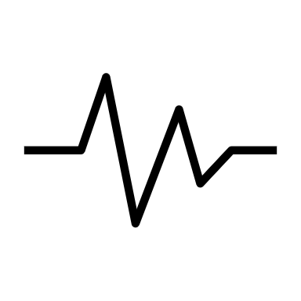


EACH YEAR
15 million
People suffer a stroke
5 million
People die
5 million
People are left permanently disabled
*data updated to 2019

Slide 3
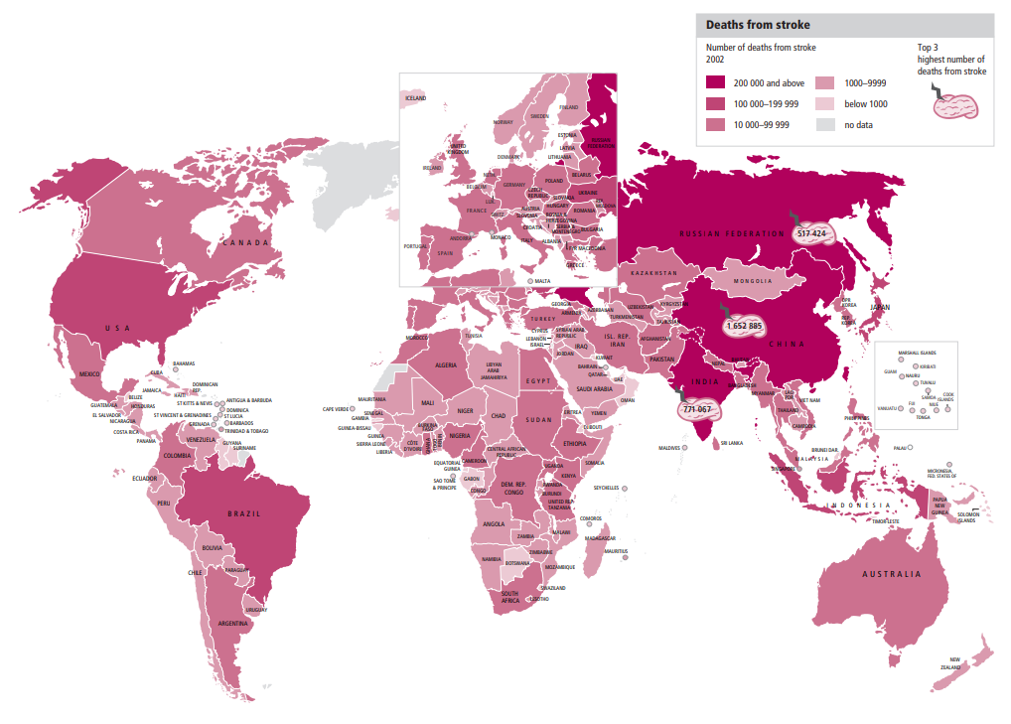


Slide 4
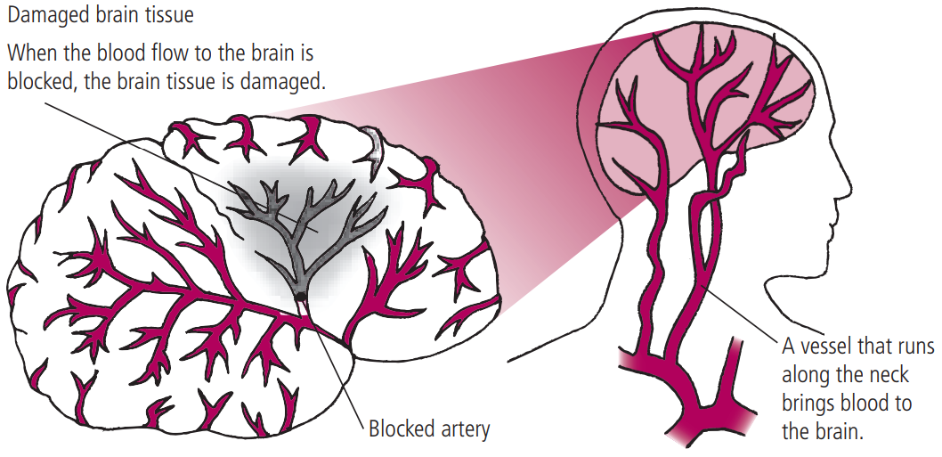
What is a stroke?
Two large blood vessels bring blood from the heart to the brain. The blood vessels branch off until tiny blood vessels supply oxygen and nutrients to all parts of the brain. When the blood flow is cut off, the decrease in the supply of oxygen and nutrients can cause lasting damage. When the blockage is sudden, it is called a stroke.

Slide 5
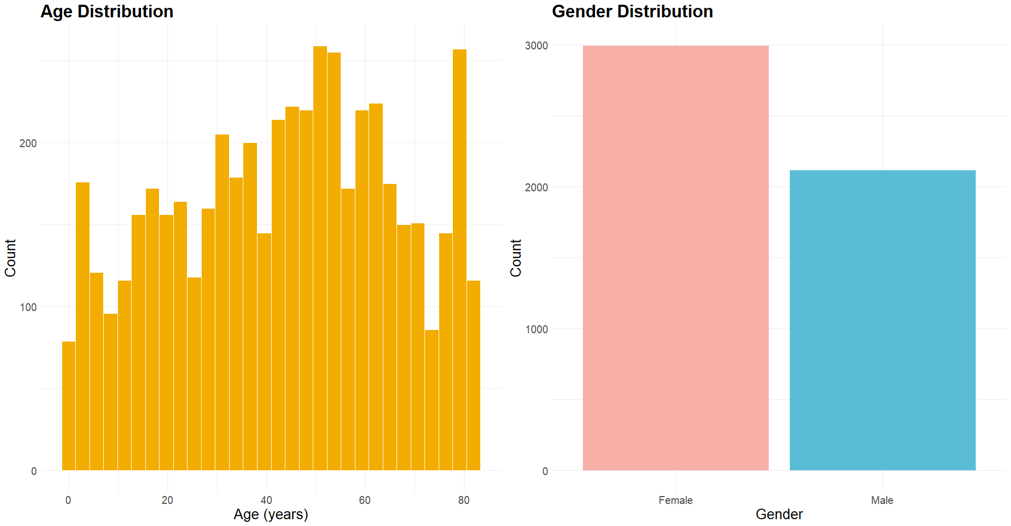
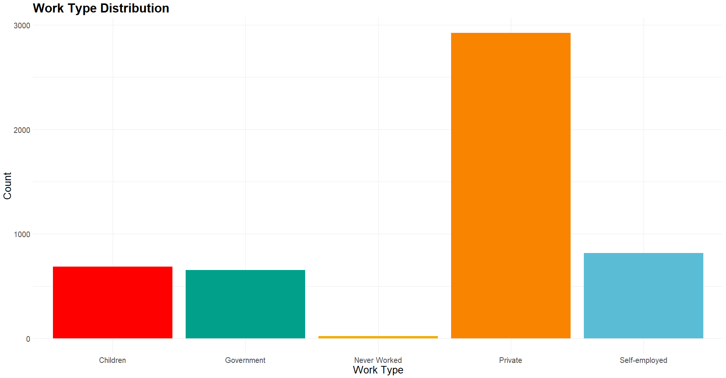
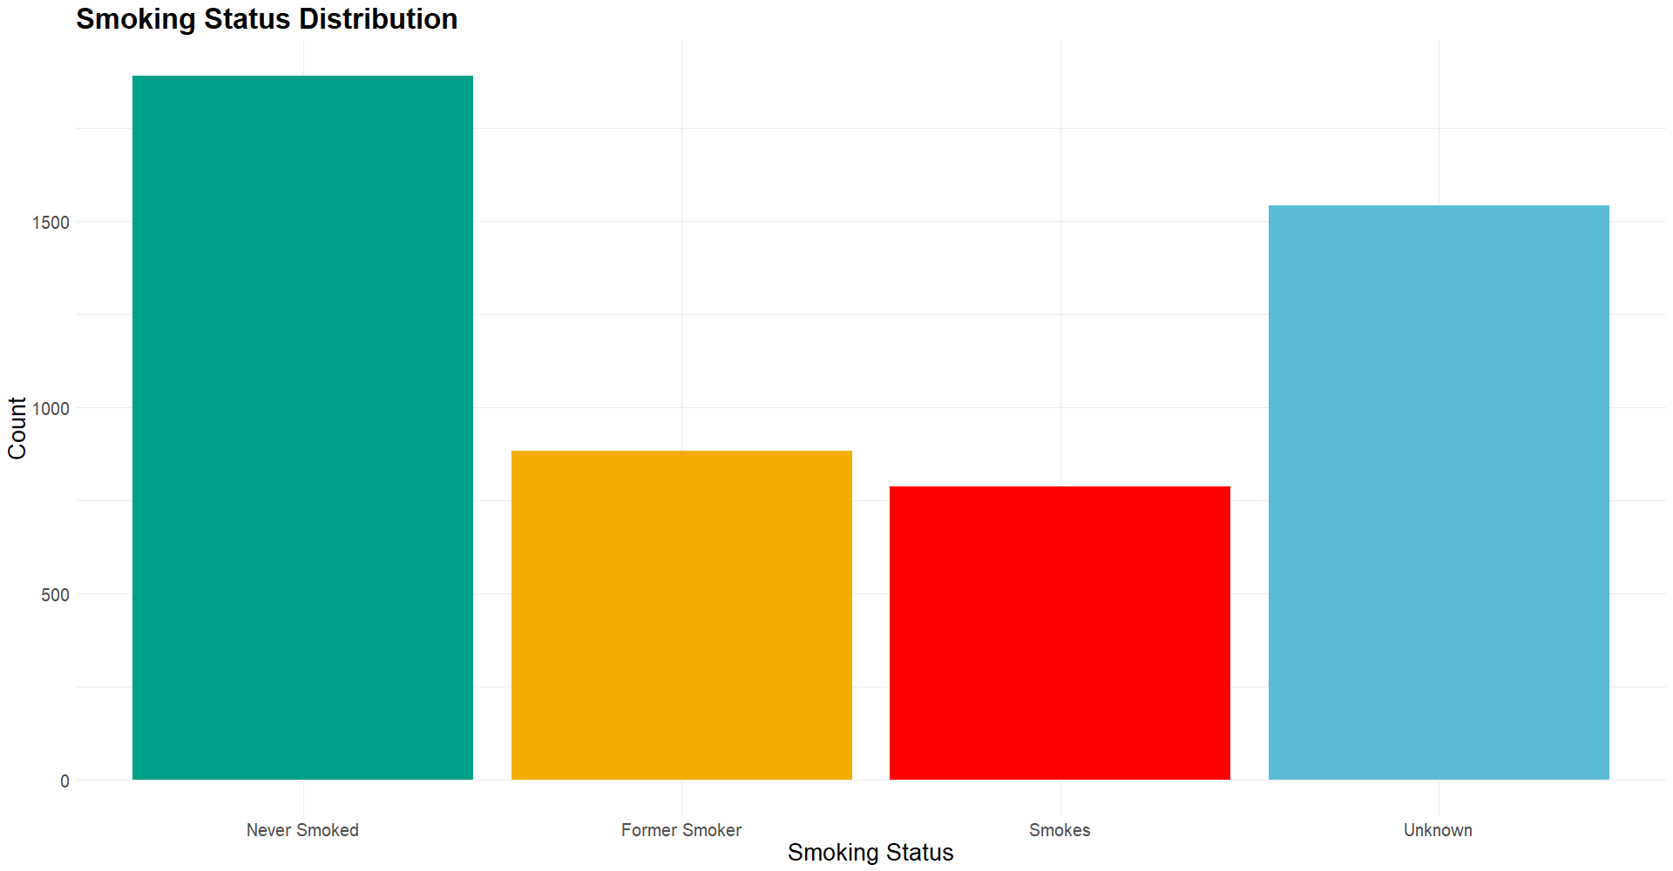
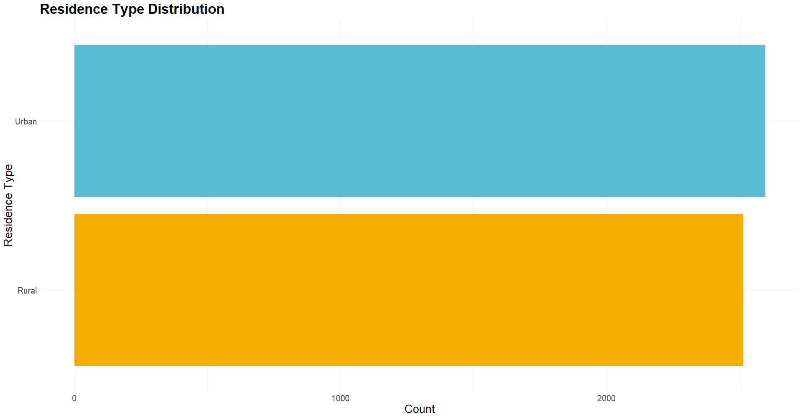
Dataset presentation
Our dataset collect a series of observations regarding lifestyle, wellness and habits of 5109 individuals (for a total of 10 features). The last feature tells weather or not the subject suffered a stroke.
58.2%
41.8%
Notes:
Gender distribution within the dataset is balanced, being male or female do not have effect on stroke.

Slide 6
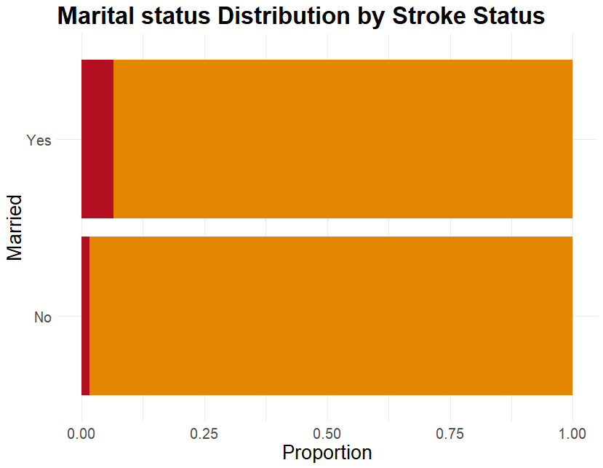

Marriage kills!
Stop getting married, do it for your loved ones!
Obviously, it is a joke! Even if some correlation between stroke and marital status was observed, it has mostly to deal with randomness.

Slide 7
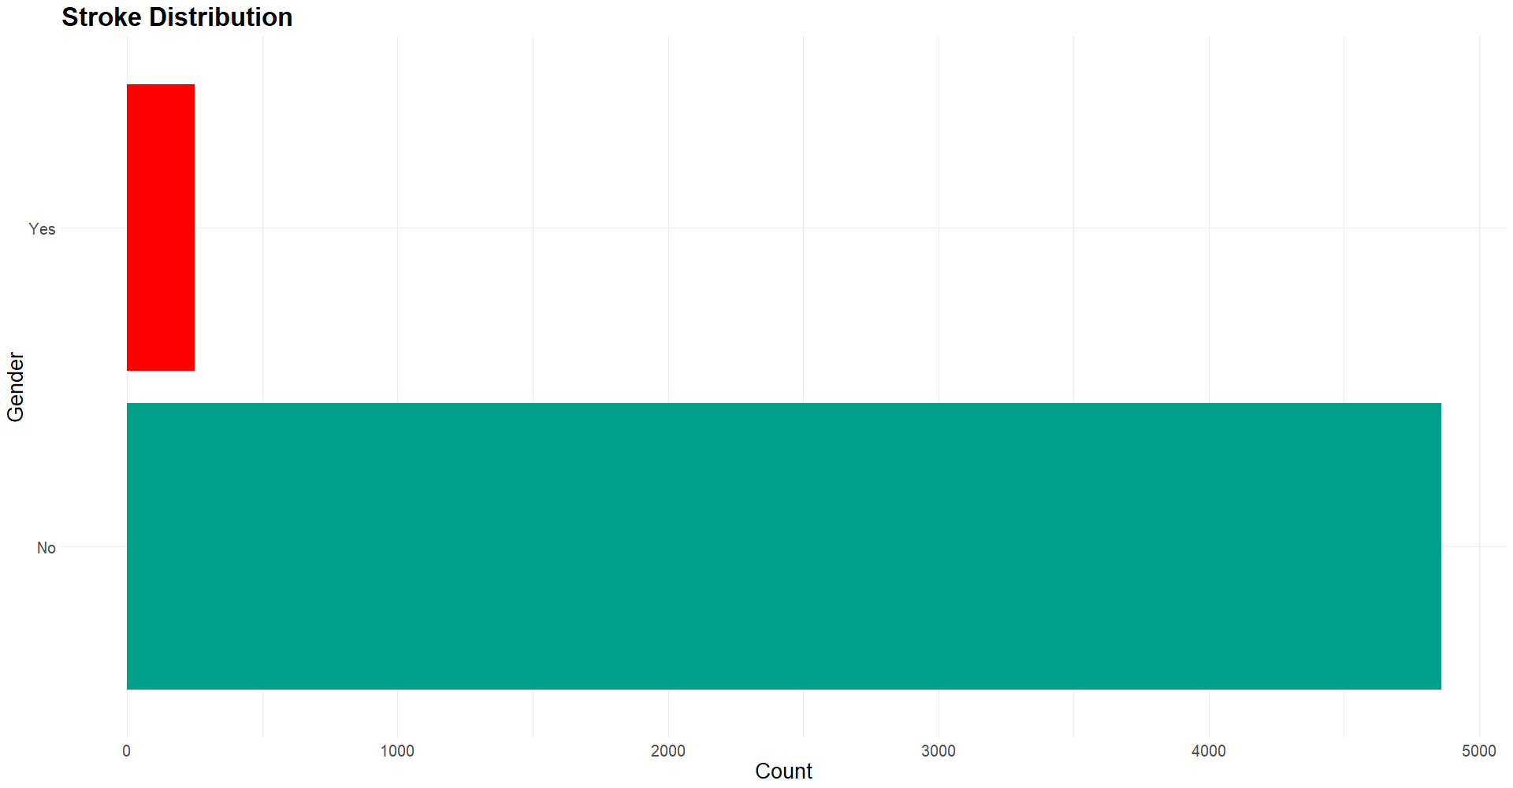
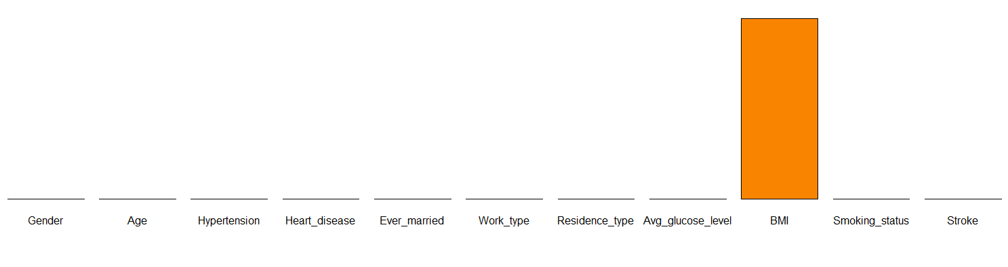
Missing values and adjustments
Missing values
Problem of unbalanced data
We had to deal with 201 NAs, present only in the BMI feature.
249 stroke over 5109 units observed (4.87%)
201
We tried to discover hidden patterns inside NAs, however nothing interesting was found. It is not possible to drop this observation since they represent roughly 16% of stroke observations. Hence, we proceeded by imputing them with a decision tree based on median BMI value by age.
Resampling with ROSE: it uses smoothed bootstrapping to draw artificial samples from the feature space neighborhood around the minority class. It handles both continuous and categorical data by generating synthetic examples from a conditional density estimate of the two classes. Presence of inadmissible synthetic data.
Notes:
20% test + 80% trainig → dal training

Slide 8

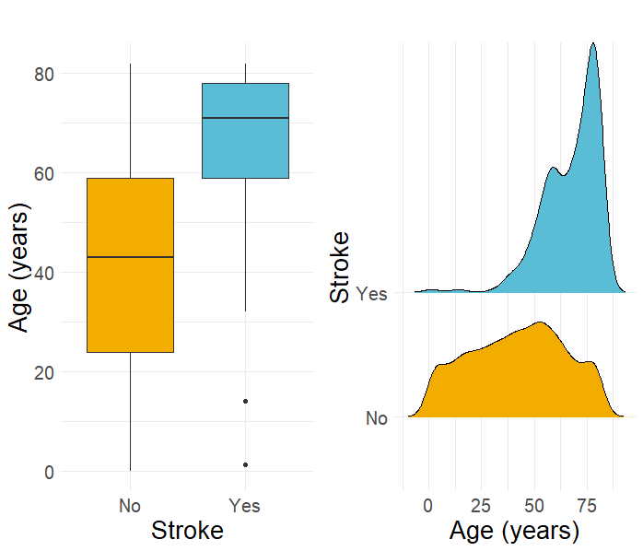
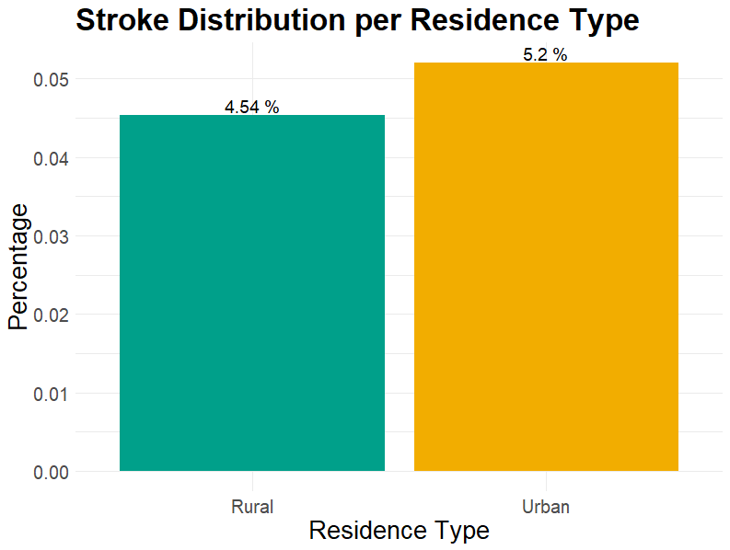
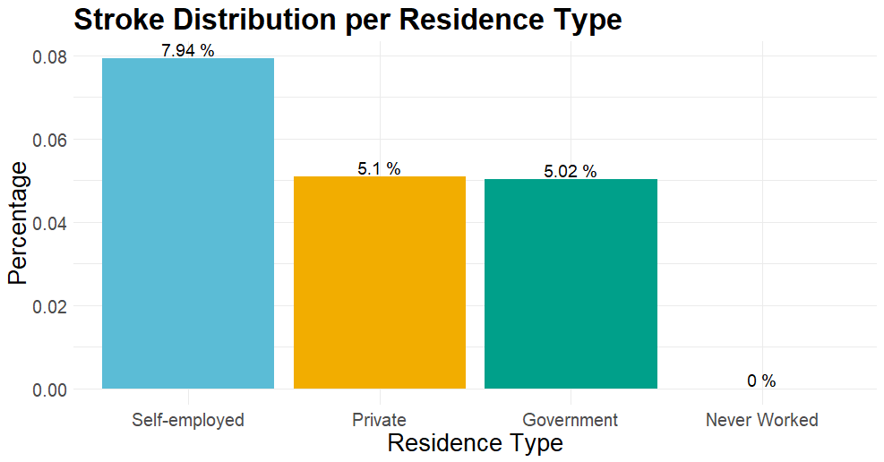
Lifestyle and strokes
Living place, Work type and Age
Difference incidence of stroke on people living in urban area vs people living in a rural side might be traceable to the effects of pollution.
Retain from working for a long-lasting life? This relationship is not very clear, might be explained by different stress level and “sedentariness” of the work type.
By far age is the most evident feature related to strokes. Keeping in mind the previous slide on how strokes happen this result is straightforward. Better not get old!

Slide 9
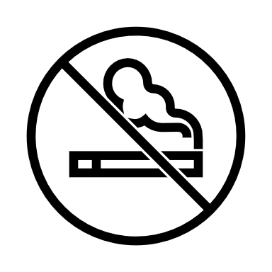
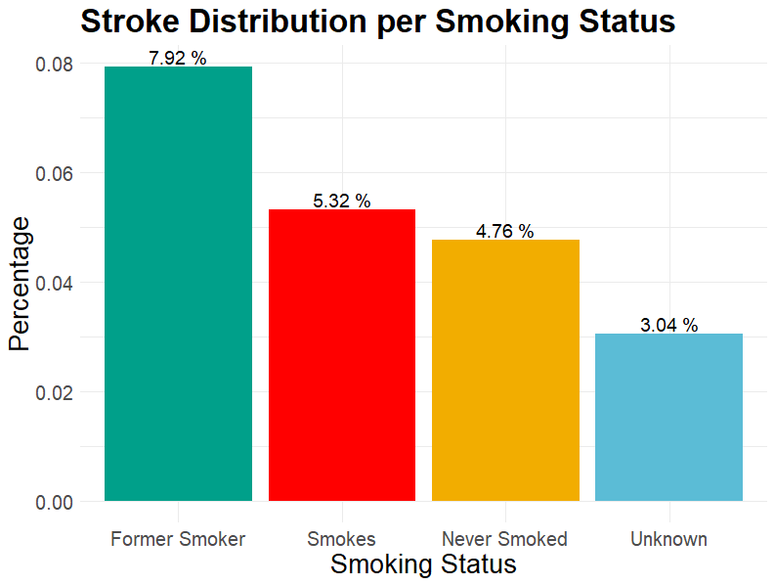
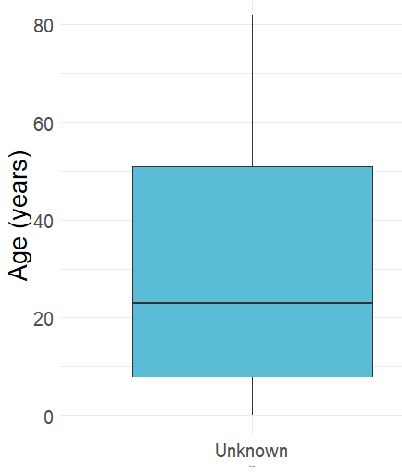
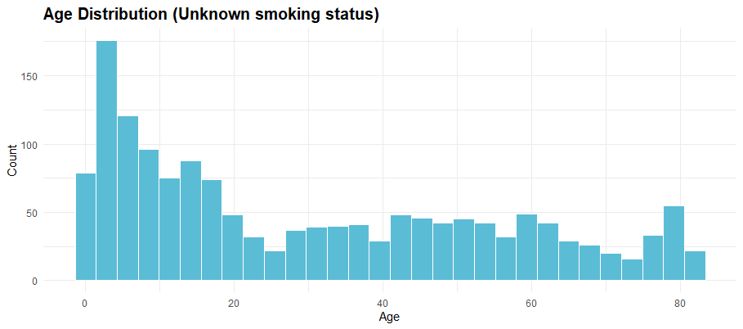
Smoking and strokes
Unknown category
Unknown status represent the 30.2% of the whole dataset. Since stroke among those units in quite rare (3.04%) further investigation were needed. We figured out that almost 40% are children (young people are less affected by strokes)
Indeed, there is evidence that smoking increase possibilities of stroke. However, Former Smoker we would expect a value lower than actual Smokers. But what if the causality is the other way around: they are former smokers since they suffered a stroke?
Stopping tobacco use at any age results in health benefits right away. It will reduce your chances of having a heart attack or a stroke from the day you stop! It will also reduce your chances of having other health problems, such as cancer and lung disease.

Slide 10

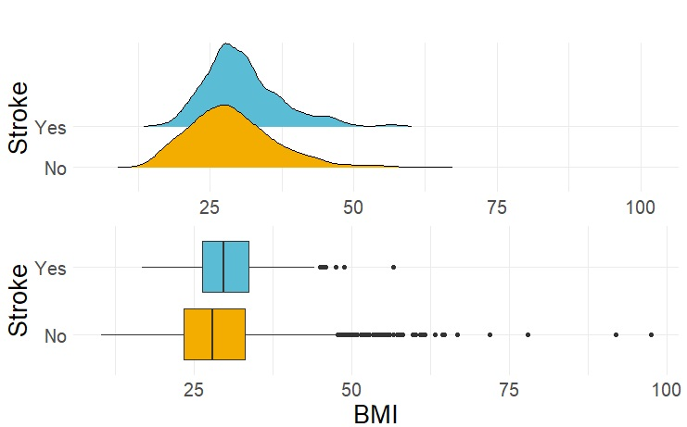
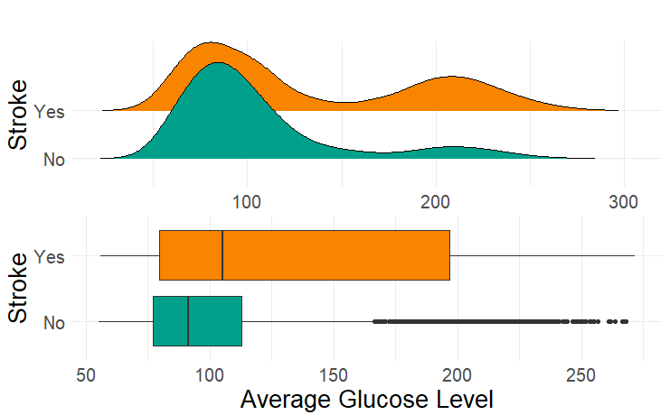
Diet and strokes
BMI and Average Glucose Level
Strokes occurs when blood is unable to flow correctly through vessels, often the blockage is a build-up of fatty deposits This makes the blood vessels narrower and less flexible.
Eating healthy food (fruit and vegetables), limiting your salt intake and taking regular physical activity, help to prevent heart attacks and strokes.

Slide 11

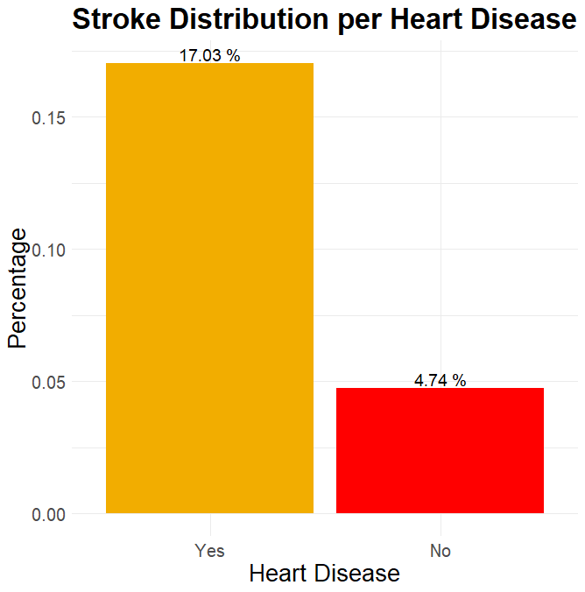
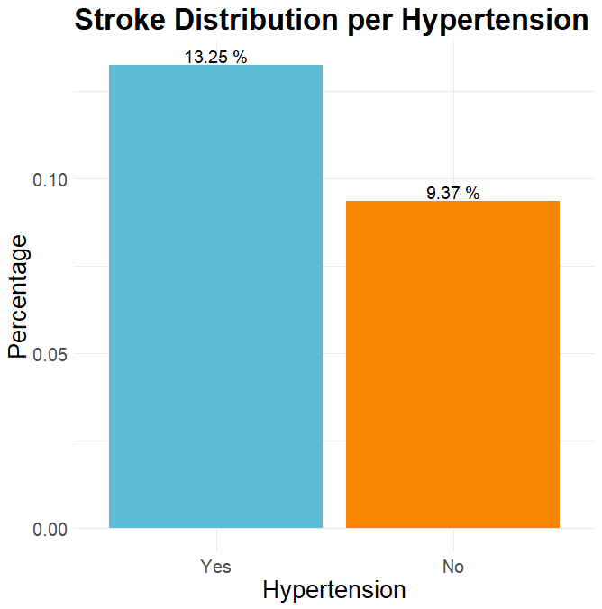
Clinical history and strokes
Heart disease and Hypertension
People who suffer Heart Disease are more likely to have Strokes, heart disease in fact can affect the blood pressure and the pumping capacity of the heart.
High blood pressure is one of the biggest risk factor for strokes. To avoid high blood pressure, you need to stay active, maintain a healthy body weight, and eat a healthy diet.
Notes:
If blood pressure is high, the heart is working harder than it should; over time, this will cause it to weaken.

Slide 12
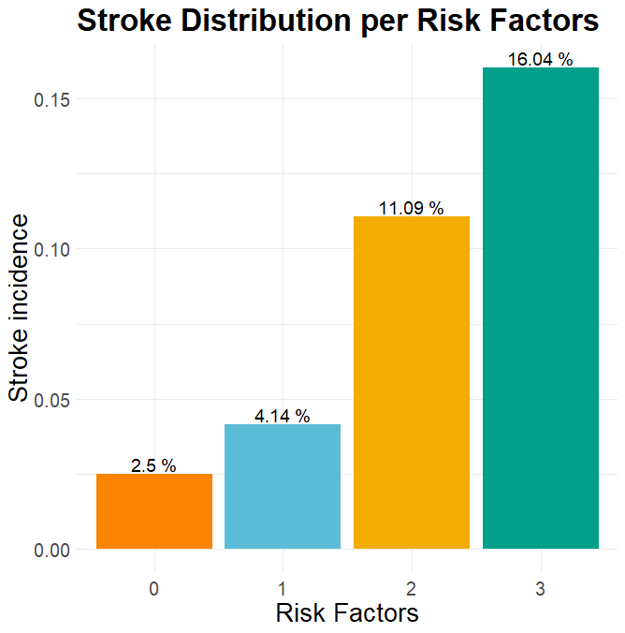
People at risk in our dataset
“If a person has two or more of the three risk factors
1) High blood pressure (represented by Hypertension)
2) High blood sugar (represented by Avg Glucose Level*)
3) High blood fats (represented by BMI**)
The risk of heart attacks and strokes is greatly increased. The more risk factors, the higher the risk.”
*Avg Glucose Level threshold set at 155 mg/dl
** BMI threshold set at 30kg/m2

Slide 13
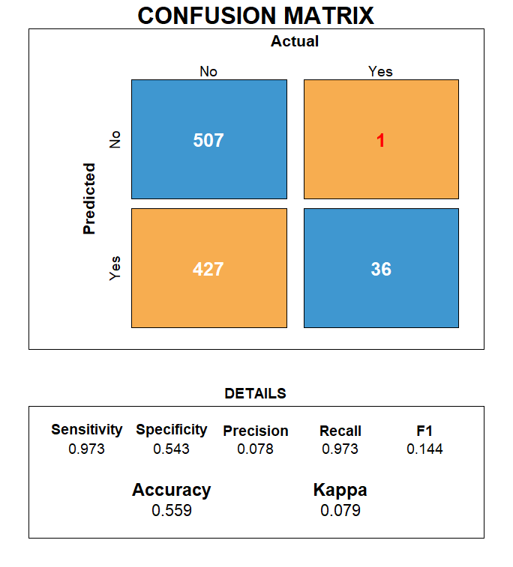
Stroke prediction for prevention
Logistic regression with cross validation
Oversampling with ROSE applied on the training dataset during the cv process to avoid the use of information already present in the validating phase (this could lead to overfitting or misleading results.)
No-Information Rate: 96%
Our focus is not on the total Accuracy but on the RECALL because we are dealing with a preventive diagnosis that can avoid death.
Low precision: It is far better to predict a people positive when it is not in the reality than missing a real positive. Screening for ictus is not invasive and require a short time.

Slide 14
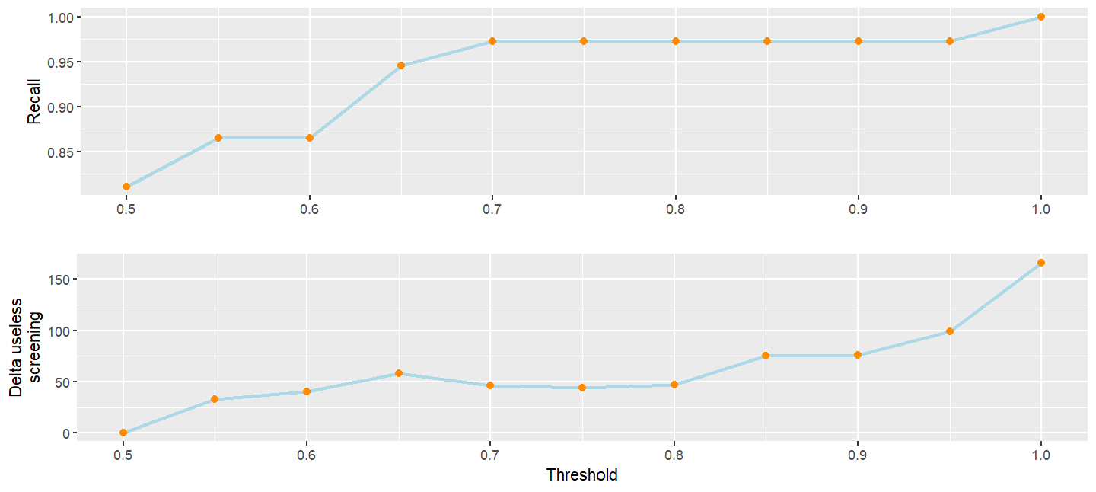

Slide 15

THANKS!
Any questions?
THIS PROJECT USES DATA FROM:
https://www.who.int/
https://world-heart-federation.org/
https://www.kaggle.com/fedesoriano/stroke-prediction-dataset

